Slide 1

Eaton 93PM UPS
30 – 500 kVA
Highest availability for mission critical applications
at the lowest Total Cost of Ownership
Notes:
The most advanced UPS for medium and large data centres and mission critical applications

Slide 2

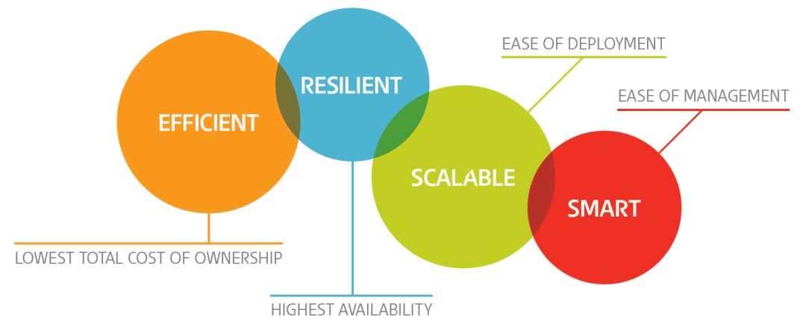
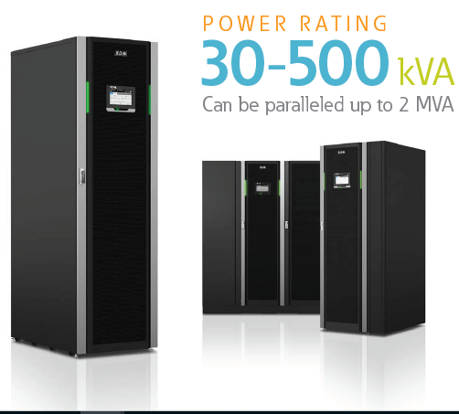
Eaton 93PM UPS
Successful Eaton 93PM platform
Global installed base > 500 MVA
Market leading online efficiency of 96,7%
Key Eaton technologies (ESS, VMMS, HotSync)
Intuitive LCD touchscreen user interface
Complete range from 30 kVA to 2,0 MVA
Modular, scalable design
Up to 500 kVA rated power in a single frame
Made in Finland
Notes:
500 MVA equals 10 000 UPM’s

Slide 3
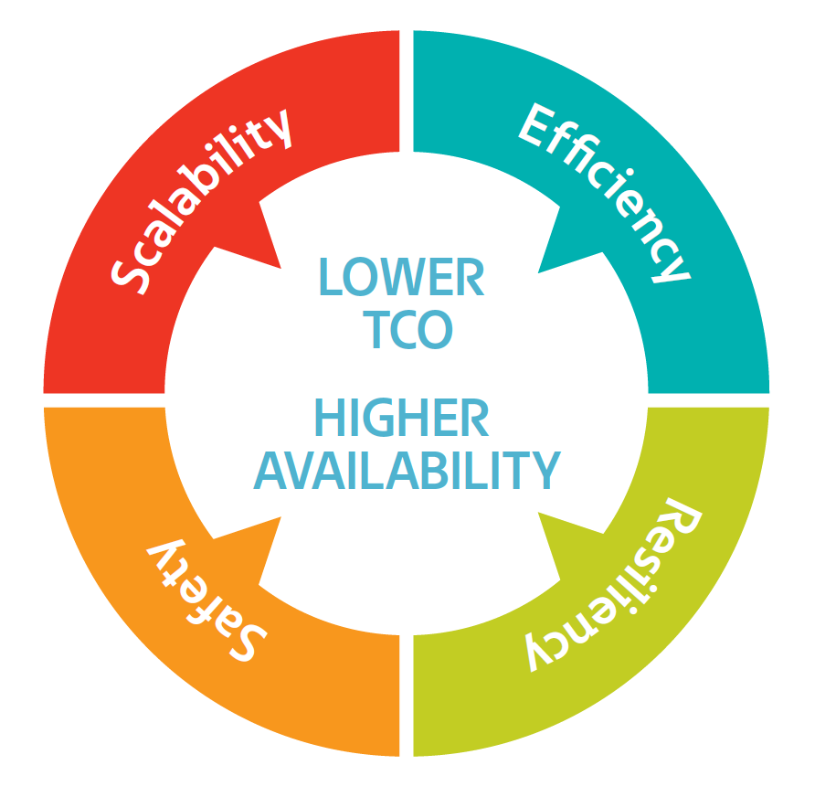
Eaton 93PM UPS
Efficiency
Scalability
Optimize capital expenditure by the pay-as-you-grow approach
Modular structure allows matching the UPS size and load demand
Higher sustainability, through reduced carbon emissions.
Minimize operational expenditure with market leading efficiency
Personnel ALWAYS safe
The important safety requirements are implemented into the UPS design as standard.
Safety
Smooth fit to surrounding power distribution + Generator compatibility
It’s all about availability secured by Hotsync technology
Resiliency

Slide 4
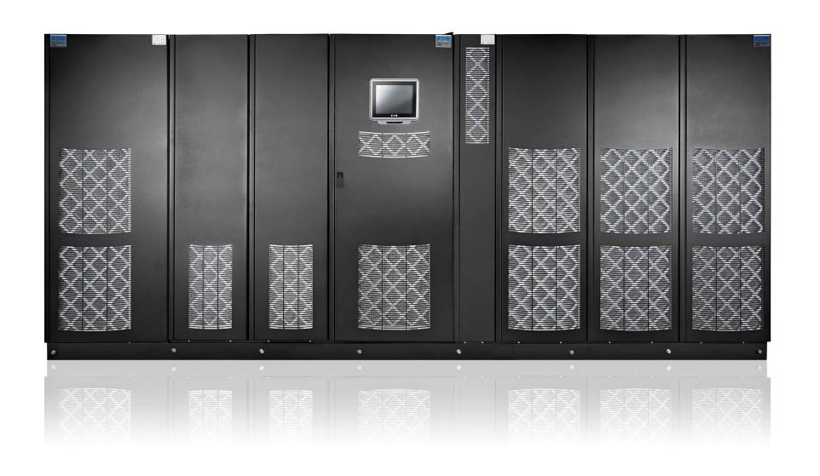
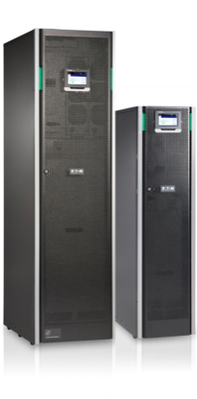
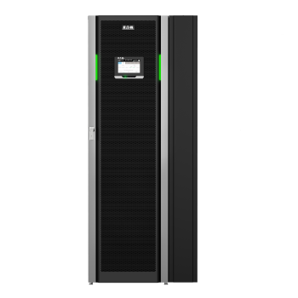
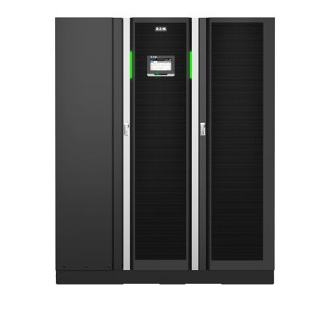
Eaton 93PM UPS
Key applications
  Medium and large data centers
  Finance and banking critical infrastructure
  Commercial buildings and industrial complexes
  Healthcare
  Telecommunications installations
  Process control equipment
9395P 250 – 6000 kVA
93PM 30 – 2000 kVA
93PS 8 – 160 kVA

Slide 5
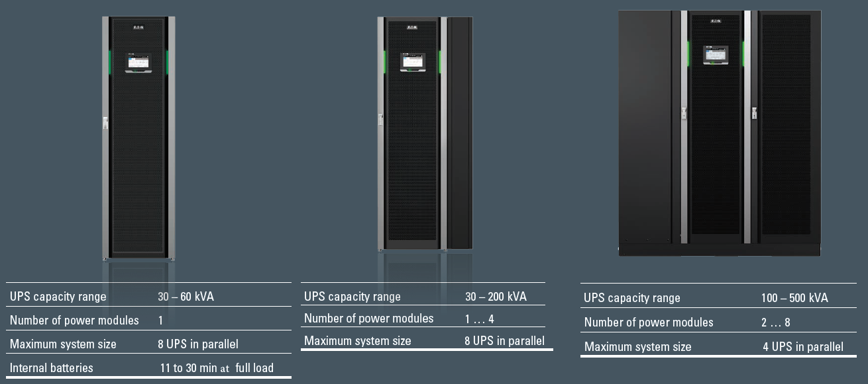
Eaton 93PM UPS

Slide 6



Lowest Total Cost of Ownership
Eaton 93PM UPS offers technologies that help you significantly lower the Total Cost of Ownership (TCO) of your UPS system
High Double Conversion efficiency
  A result of successful implementation of 3 level IGBT technology
Variable Module Management System (VMMS)
  Maximised efficiency in double conversion mode – even on lower load levels
Energy Saver System (ESS)
  The ultimate savings = up to 99,3% efficiency
Easy Capacity Test (ECT)
  Savings through reducing the need of external equipment in annual battery autonomy tests

Slide 7
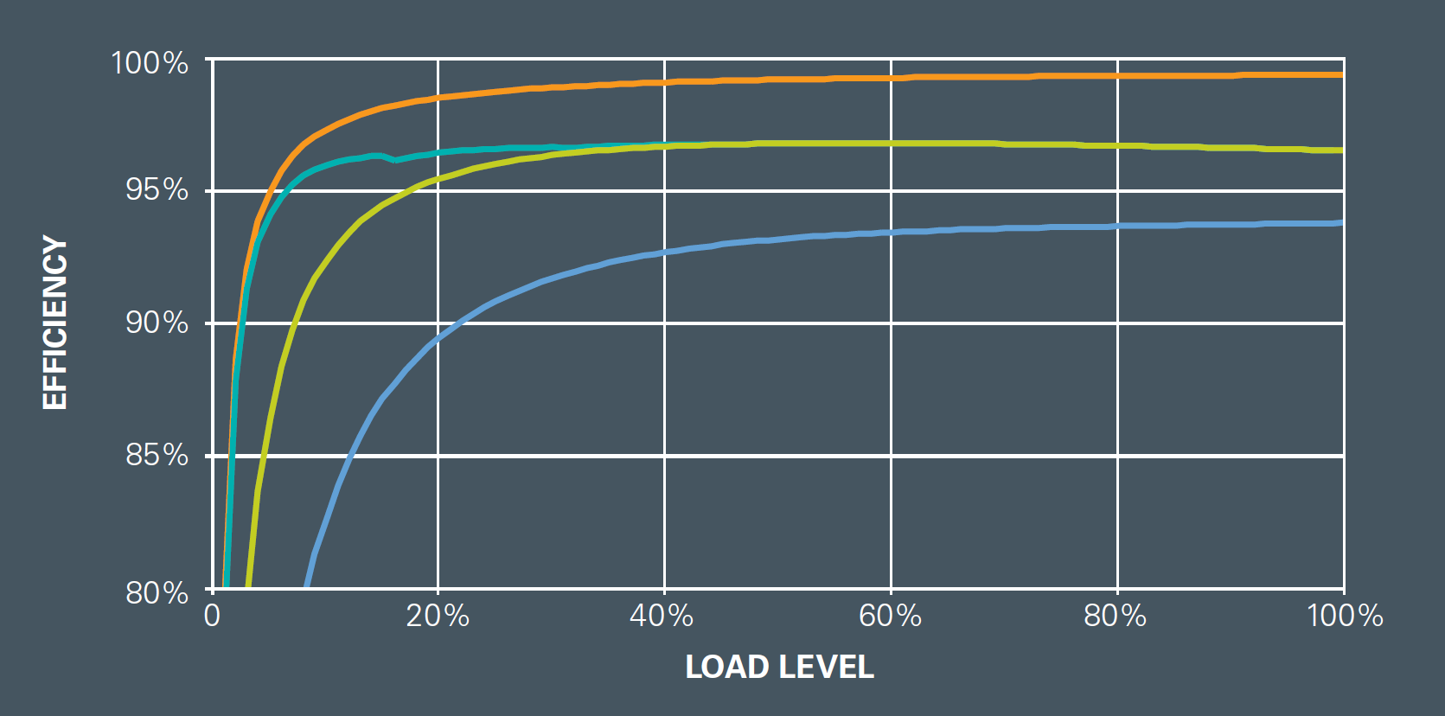

Lowest Total Cost of Ownership
Industry leading energy efficiency
Power is a major operating expense for data centres
Eaton 93PM Efficiency
97%
Typical UPS operating range

Slide 8
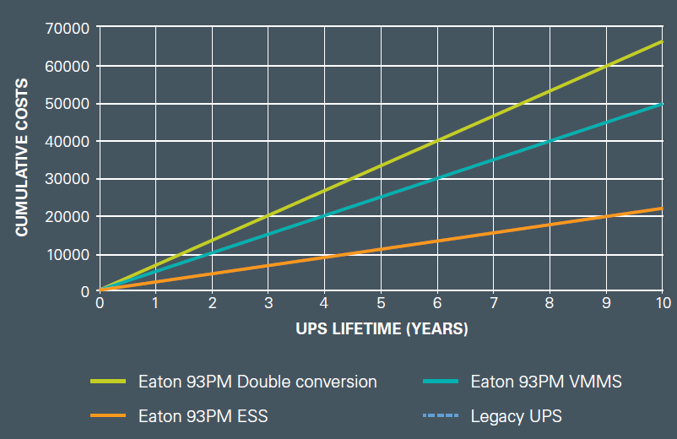
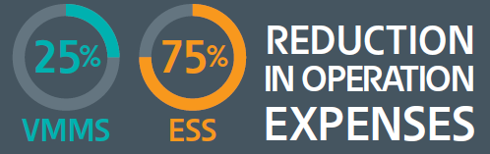

Total cost of ownership

Slide 9
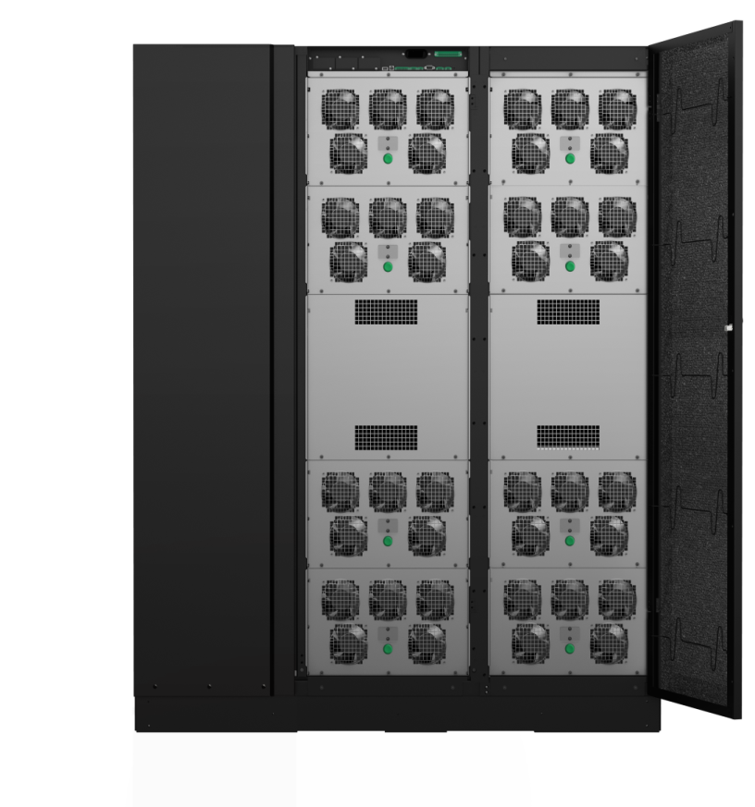

Scalability
Mix and match
Size static bypass to match higher fault current levels of the installation
Optimize the number of power modules (UPM’s) to needed capacity
Increase capacity at any time, simply by more adding power modules
The static bypass is always rated at the UPS’s maximum capacity
Parallel up to 4 UPS’s in the same system
Day 1 capacity
Day 2 capacity
4
4
8
8
3
3
7
7
Fully rated
Static Switch
2
6
6
1
5
5

Slide 10


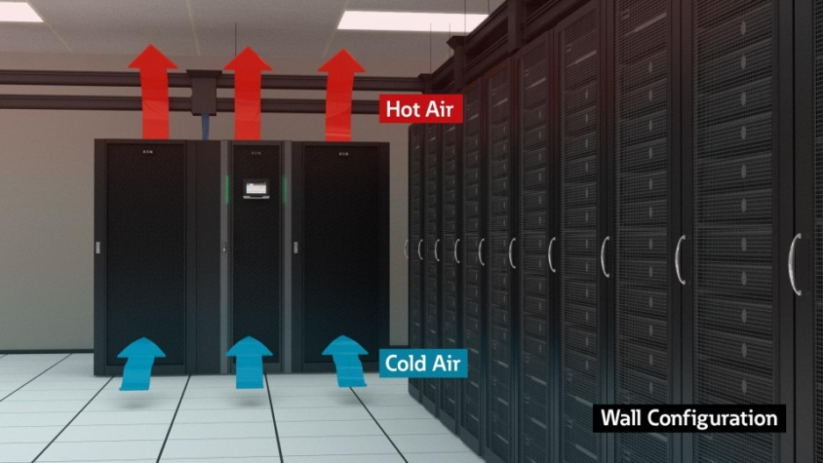
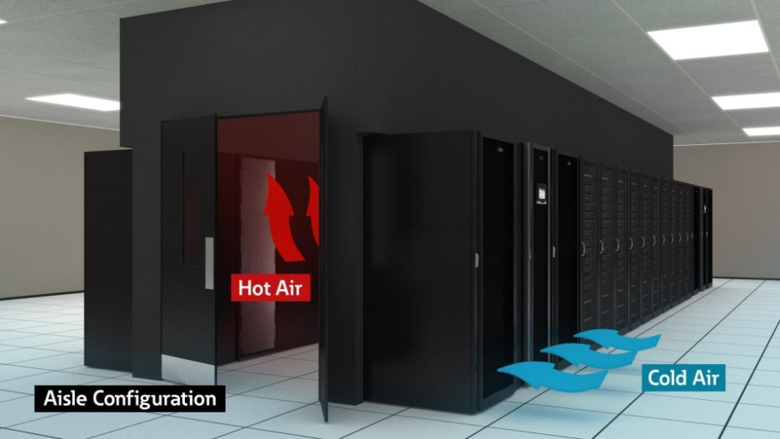
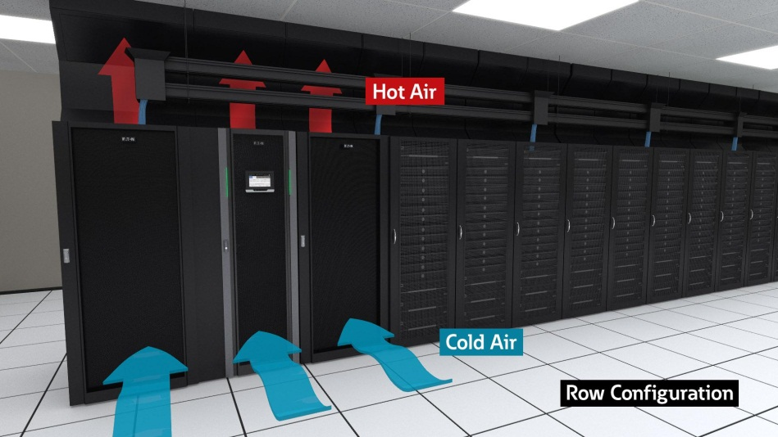
Ease of deployment
Against-the-wall configuration utilising a Top-air-exhaust kit
Front-to-back airflow is optimal for hot/cold aisle configurations
Maximises deployment flexibility by providing innovative thermal management options.

Slide 11
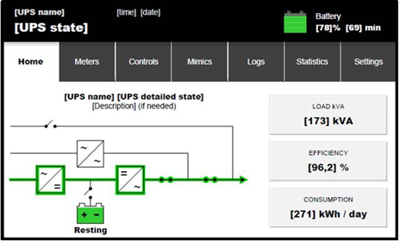
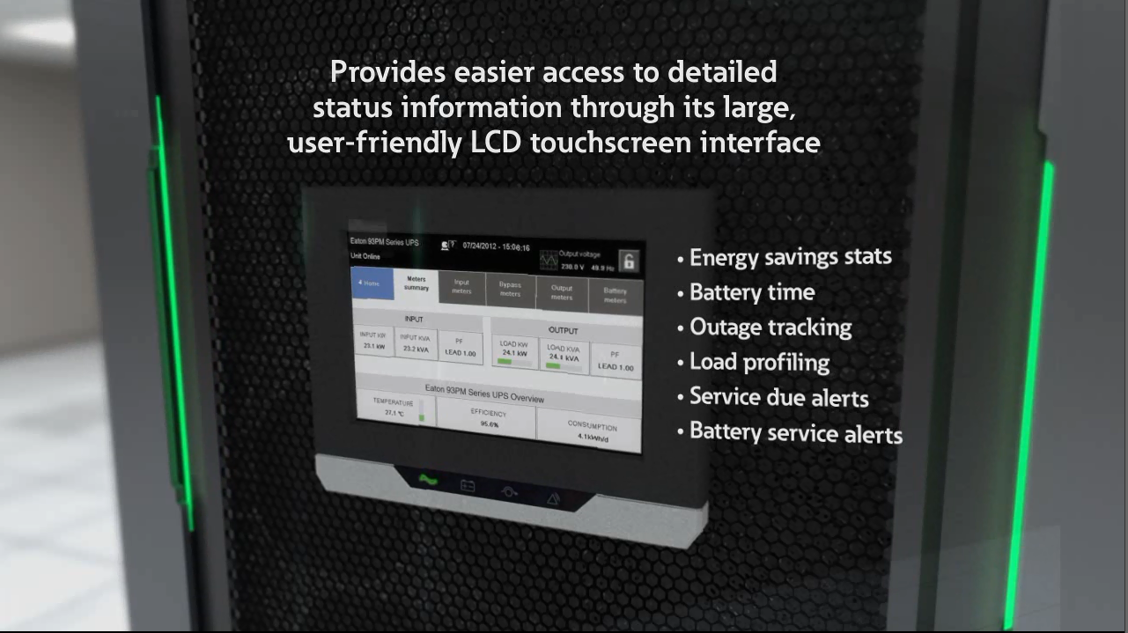
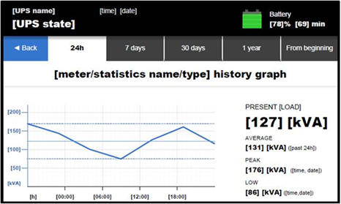
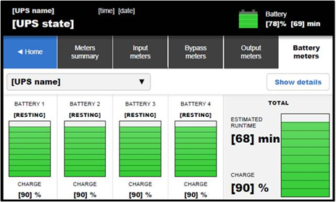
Ease of management
Monitor system status information visually

Slide 12
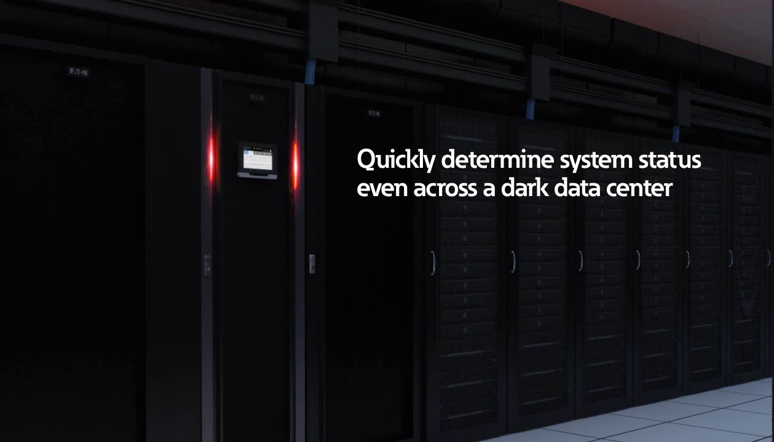
Ease of management
Green LED’s -> System online and normal.
Yellow LED’s -> System on battery or bypass.
Red LED’s -> Service required.

Slide 13
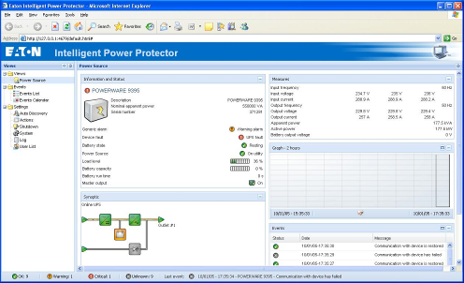





Ease of management
Top-class intelligent software solutions
Web interface as standard
  Integration to IT and management systems
  with SNMP
Intelligent Power Software bundled
  Monitor and manage your UPS system as an integral part of power and IT infrastructure
  Web-based interface allows monitoring of multiple UPS through any device with a browser
  Link to virtualisation management systems (vCenter, XenCenter, Systems Center)
  Migrate virtual machines to other sites in case of power failure

Slide 14
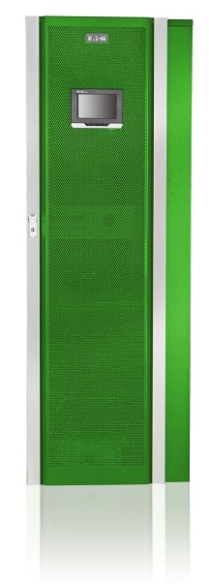
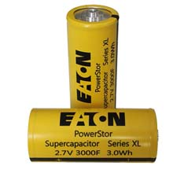
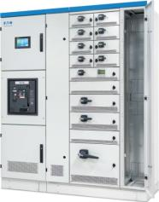
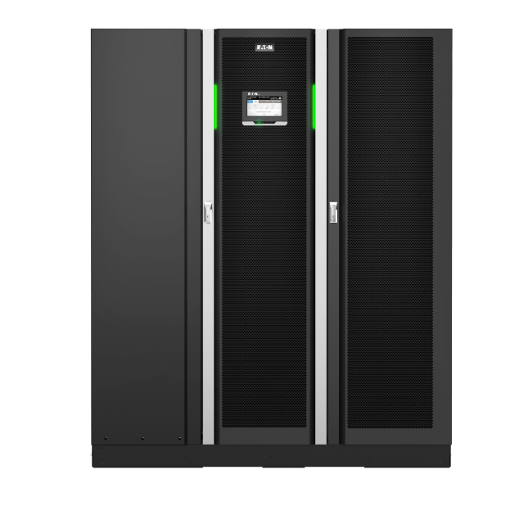
Eaton 3ph UPS Accessories
Energy source options
VRLA batteries
Lithium-ion batteries
Supercapacitors
General accessories
Static transfer switches (93STS)
Communication options
  Web/SNMP, Modbus, dry-contacts
93PM battery cabinets & breakers
93PM options
Front-to-top air flow kit for installation against the wall
Paralleling kit
Single or dual feed input
Gland plates for cabling
Custom-made solutions
Special colours
Synchronization options
  Sync control between multiple systems
  Block synchronization
Integrated switchgear + UPS
= Eaton Connected
+

Slide 15
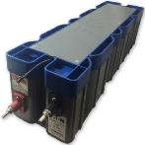
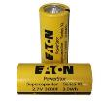
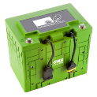

Energy source options
No matter what is the preferred energy source, Eaton UPSs are compatible with it!
Supercapacitors
Short back up time requirements, Short recharging time
Multiple discharges
High ambient tolerance
Li-Ion batteries
High Power density, Light weight
Multiple discharges
Higher ambient tolerance
VRLA batteries
Still dominant and cheapest
Ambient temperature limitations
Limited no of discharges
Optimal back up time

Slide 16

Eaton 93PM UPS
Introducing the Eaton 93PM UPS, helping you to combat the costs of energy and the ever-increasing power demands of IT infrastructure
The argument for the
93PM really adds up

Slide 17


