Slide 1
Suggestion on How to Use
Industry Trainers are encouraged to use this material in their sessions
Download the presentation file
Print the Notes pages and read them as you view the presentation in the “Slide Show” view. In this way you see the slides in large format and have animation (when available)
Notes:
Suggestion on How to Use
Download the presentation file. Print the Notes pages and read them as you view the presentation in the “Slide Show” view. In this way you see the slides in large format and have animation (when available).

Slide 2
Series Rated Systems

Slide 3
Agenda
Interrupting Rating
Fully Rated versus Series Rated
NEC® Requirements
“Misunderstandings”
Inspecting Systems Using Series Rated Combinations
Notes:
Overcurrent devices have three ratings that must be observed for proper applications. They are the voltage rating, current rating, and interrupting rating. This presentation covers specific aspects of interrupting ratings. It looks at the two methods of achieving adequate interrupting ratings; fully rated and series rated systems. It examines the National Electrical Code requirements surrounding series rated systems. It covers some of the common misunderstandings surrounding series rated systems. And finally, it looks at the inspection of series rated systems.

Slide 4
Interrupting Rating
NEC® Article 100 -Definitions
The highest current at rated voltage that a device is identified to interrupt under standard test conditions
Notes:
The National Electrical Code defines interrupting rating as “The highest current at rated voltage that a device is identified to interrupt under standard test conditions”

Slide 5
How Is Interrupting Rating Properly Applied
Overcurrent Protective devices must be rated to interrupt the maximum available short-circuit current at their point of application (lineside terminals)
Notes:
Overcurrent Protective devices must be rated to interrupt the maximum available short-circuit current at their point of application (lineside terminals)

Slide 6
How Is Interrupting Rating Properly Applied
Isca 1
1st
Determine Isca at lineside
terminals of each OCPD
2nd
Select OCPD’s with
adequate A.I.R.
Isca 2
MSB
Isca 3
Isca 4
Isca 5
Isca 6
M
M
Notes:
In order to properly apply interrupting ratings, short circuit calculations must be made for every switchboard, panelboard, loadcenter, motor control center, busway, and any other locations that contain overcurrent protective devices. Note that these calculations are made before the current limitation of any of the overcurrent devices is determined. For calculation purposes, assume that the fuses and circuit breakers are replaced by copper bars of comparable impedance.

Slide 7
Interrupting Rating
One of the Most Critical Overcurrent Protective Device Ratings
  NEC® Sections 110.9
  110.22
  240.86
Notes:
There are three sections of the National Electrical Code that refer to interrupting ratings. 110.9 covers interrupting ratings in general, while 110.22 and 240.86 address series rated systems in particular.

Slide 8
Section 110-9
NEC® Section 110.9 requires fuses or circuit breakers to have an interrupting rating equal to or greater than the maximum available short-circuit current.
Notes:
Section 110.9 requires fuses and circuit breakers to have an interrupting rating equal to or greater than the maximum available short-circuit current at their line side.

Slide 9
Interrupting Rating Requirements
Two ways to satisfy
  Fully Rated
  Series Rated
Notes:
There are two ways to meet the requirements of Section 110.9- fully rated, and series rated systems.

Slide 10
Fully Rated Systems
Fully Rated Systems
  Circuit Breakers
  Fuses
  Combination of both
Notes:
Fully rated systems can be all circuit breakers, all fuses, or combinations of circuit breakers and fuses.

Slide 11
Fully Rated Systems
Definition:
A system where each overcurrent protective device has an individual interrupting rating (stand alone) at least as great as the available short-circuit current at point of application.
Notes:
A fully rated system can be defined as:
A system where each overcurrent protective device has an individual interrupting rating (stand alone) at least as great as the available short-circuit current at point of application.

Slide 12
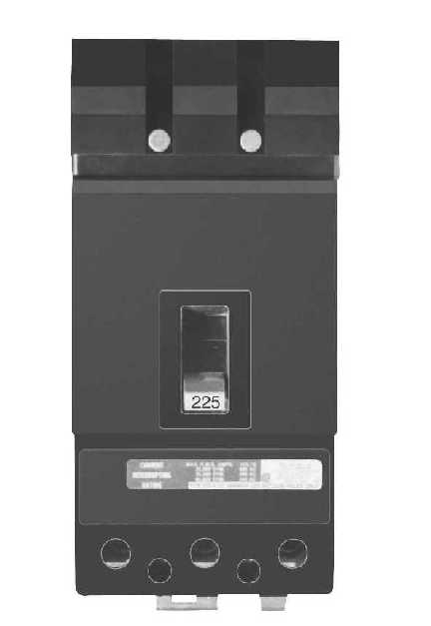
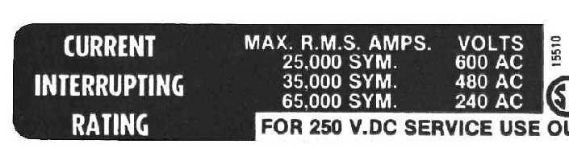
Select OCPD’s with I.R. equal or greater than short-circuit current available at each point of application
Notes:
Here is a sample of a circuit breaker label with fully rated interrupting ratings of 25kA @ 600 volts, 35kA @ 480 volts, and 65kA @ 240 volts.

Slide 13
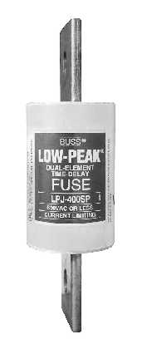
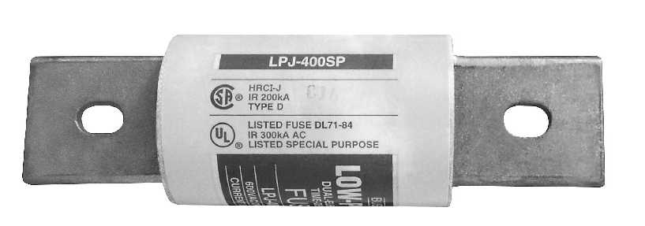
Select OCPD’s with I.R. equal to or greater than short-circuit current available at each point of application
300,000 Amp Interrupting Rating
Notes:
And here’s an LPJ-400SP, Class J, 400 ampere label showing a 300,000 ampere fully rated interrupting rating.

Slide 14
Series Rated Systems
A combination of
circuit breakers / circuit breakers or fuses / circuit breakers
that can be applied at available fault levels above the interrupting rating of the load side circuit breaker, but not above that of the main or line side device.
Notes:
A series rated system can be defined as follows:
A combination of
circuit breakers / circuit breakers or fuses / circuit breakers
that can be applied at available fault levels above the interrupting rating of the load side circuit breaker, but not above that of the main or line side device.

Slide 15
Series Rated Systems
NEC® 240.86
  Where a circuit breaker is used on a circuit having an available fault current higher than the marked interrupting rating by being connected on the load side of an acceptable overcurrent protective device having a higher rating,...
Notes:
Here’s what 240.86 has to say about series ratings.
Where a circuit breaker is used on a circuit having an available fault current higher than the marked interrupting rating by being connected on the load side of an acceptable overcurrent protective device having a higher rating,...

Slide 16
Series Rated System CB /CB
Series Rated
Combination
65,000 A.I.R.
200A Circuit Breaker
65,000 A.I.R.
20A Circuit Breaker
10,000 A.I.R.
I_{SC}=65,000 A
I_{SC}=65,000 A
Notes:
Here is a 20 amp circuit breaker with a 10 kA individual interrupting rating that is series rated with an upstream 200 amp circuit breaker that has an individual interrupting rating of 65 kA. The series rating, also 65 kA, is the result of listing agency testing.

Slide 17
Series Rated System Fuse/CB
Series Rated
Combination
200,000 A.I.R.
LPJ 400 SP
300,000 A.I.R.
20A Circuit Breaker
10,000 A.I.R.
I_{SC}=300,000 A
I_{SC}=200,000 A
Notes:
And here is a 20 ampere circuit breaker with an individual interrupting rating of 10 kA that is series rated with a 400 ampere Class J fuse with an individual interrupting rating of 300kA. The series rating is for 200,000 amperes, which covers any available short-circuit current up through 200,000 amperes RMS.

Slide 18
NEC® Requirements for Series Rated Systems
Notes:
There are additional National Electrical Code requirements that need to be understood.

Slide 19
Series Rated Systems
Limitations and additional NEC® requirements
  Tested vs. Engineered Combinations
  Panel manufacturer’s labeling
  Installer’s field labeling
  Motor contribution limits
  Lack of selective coordination
  Future expansion issues
Notes:
The NEC has one set of requirements for tested combinations and another set of similar requirements for engineered combinations. There are NEC requirements for both manufacturers’ labeling and field labeling. There are limits for motors connected between the line-side device and load-side device. There are locations where series ratings should not be used because of selective coordination requirements. And, there are issues with future expansions.

Slide 20
Series Rated Systems
Engineered Series Rated Combinations
  Existing installations only, where available short-circuit current now exceeds the individual (stand alone) interrupting rating of downstream circuit breakers
  Load side (protected) circuit breakers must remain passive while the line side (protecting) overcurrent device is opening the circuit.
    Most thermal magnetic, molded case circuit breakers will not meet this requirement
Notes:
There are very strict requirements for engineering a series rated system. It is only allowed for existing installations where the downstream circuit breakers do not begin to open while the upstream fuse or circuit breaker opens the circuit. Most modern thermal magnetic, molded case circuit breakers do not meet this requirement of being passive while the upstream fuse or upstream circuit breaker is opening the circuit.

Slide 21
Series Rated Systems
Tested Series Rated Combinations
  New or existing installations
  The only method allowed for new construction
  Many hundreds of tested combinations available
    Fuse/CB
    CB/CB
Notes:
Most series rated combinations are “tested”. The tested combinations can be used for new construction and existing construction, and in fact is the only method allowed for new construction. There are many hundreds, if not thousands of tested combinations of fuses protecting circuit breakers and circuit breakers protecting circuit breakers.

Slide 22
Series Rated Systems
Panelboard manufacturer labeling NEC® 240.86 (B) (for all new construction)
  Displays List of tested combination interrupting rating for loadside circuit breaker(s) and the lineside OCPD combination
  Usually a panelboard has many combination Listings
Notes:
240.86(B) contains requirements for the manufacturers’ labels for tested combinations. Labels must show the combinations of series rated devices that are suitable for use with specific pieces of equipment. There are typically many combinations that have been tested and found acceptable.

Slide 23
Series Rated Systems 240.86 (B)
This is a required label from a panelboard
but the series ratings are not shown because all the tested combinations would not fit on the label.
Notes:
While this label doesn’t meet the specific Code requirement to show the combinations that have been tested and found acceptable, it refers to a manual that is supplied with the equipment. The manual contains the various combinations that are suitable. Replacement manuals can be obtained by calling the phone number provided.

Slide 24
Series Rated Systems
In lieu of the required label showing the combinations, UL 67 (Panelboards) allows for a bulletin to be referenced and supplied with the panelboard
Affixed to panelboard
Notes:
UL 67, the panelboard standard, allows for manuals in place of showing all of the recognized combinations. The logic for allowing a manual is that all of the combinations would take up too much room to fit on a label.

Slide 25
Series Rated Systems
Installer labeling requirement
  NEC® 110.22 (B) for engineered systems
  NEC® 110.22 (C) for tested systems
  NEC 240.86 (A) for engineered systems
  field installed
  On panelboard with loadside CB
  On feeder enclosure with lineside OCPD
Notes:
Section 110.22 calls for field installed labels on both the loadside panelboard and the lineside device, if it is remote from the loadside panelboard. 110.22 (B) covers engineered series rated systems, while 110.22 (C) covers tested series rated combinations.
240.86(A) covers the field marking requirements for engineered series rated systems. 240.86(A) requires that the series combination, including identification of the upstream device, be field marked on the end use equipment

Slide 26
Series Rated Systems
Installer field labeling requirement (con’t)
  Loadside panelboard marked with
    Short-circuit rating of series combination
    Type circuit breaker for replacement
    Part number for the lineside, feeder OCPD
    location & name of feeder OCPD panel (if remote)
Notes:
The loadside panelboard is marked with the short-circuit rating of the series combination, the type of circuit breaker that must be installed for replacement purposes, the part number of the lineside overcurrent protective device, and the location and name of the lineside device/panel if it is in a remote location.

Slide 27
Series Rated Systems
Installer field labeling requirement (con’t)
  Lineside panelboard (if remote) is marked with
    Short-circuit rating of series combination
    Part # for lineside OCPD replacement
    Location & name of loadside series rated protected panel (if remote)
Notes:
The lineside panelboard/switch is marked with the short-circuit rating of the series combination, the part number of the lineside device for replacement purposes, and the location and name of the loadside series rated protected panel.

Slide 28
CAUTION
Series Rated Combination System
with panel LDP1
Rated 100,000 Amperes
Replace with Bussmann
LPJ-400SP Fuses Only
Panel MDP1
CAUTION
Series Rated Combination System
with LPJ-400SP fuses in MDP1
Rated 100,000 Amperes
Replace with XXX
Circuit Breakers Only
Panel LDP1
Notes:
Here are examples of field installed labels to meet 110.22 and 240.86. The top, lineside device label states:
CAUTION
Series Rated Combination System
with panel LDP1
Rated 100,000 Amperes
Replace with Bussmann
LPJ-400SP Fuses Only
The bottom, loadside panelboard label states:
CAUTION
Series Rated Combination System
with LPJ-400SP fuses in MDP1
Rated 100,000 Amperes
Replace with XXX
Circuit Breakers Only

Slide 29
Series Rated Systems
Motor Contributions NEC® 240.86 (C)
  “Series Ratings Shall Not Be Used where”
    Motors connected between devices in combination
    and
    Sum of the FLC exceeds 1% of the I.R. of the lower-rated circuit breaker
Notes:
240.86(C) also limits the amount of motor load that can be connected between the lineside device and the loadside circuit breaker.
“Series Ratings Shall Not Be Used where”
Motors are connected between devices in combination
and
Sum of the FLC exceeds 1% of the I.R. of the lower-rated circuit breaker

Slide 30
Series Rated Systems
This does not comply with NEC 240.86(C)
Series Rated
Combination
22,000 A. I.R.
Motor Contribution
10,000 A. I.R.
Motor F.L.A. > 100A (1% I.R.)
Notes:
Here’s an example of a non-compliant series rated system. The motor load exceeds 1% of the interrupting rating of the load side circuit breakers. The reason for this requirement is that the system was never short-circuit tested with current that was injected in between the two devices. All testing is done so that both devices see the same amount of short circuit current.

Slide 31
Series Rated Systems
Inherently, series rated systems are not selectively coordinated - the lineside protective device has to open to protect the loadside circuit breaker
Notes:
Inherently, series rated systems are not selectively coordinated - the lineside protective device has to open to protect the loadside circuit breaker

Slide 32
Lack of Selective Coordination
Notes:
This one-line shows how the lack of selective coordination associated with series rated systems causes unnecessary power loss to other circuits.

Slide 33
Selective Coordination
Important consideration for any electrical system to avoid built-in blackouts
Series rated systems must not be used where selective coordination is required, including:
  Elevator feeders supplying two or more elevators (620.62)
  Critical Operations Data Systems (645.27)
  Emergency Systems (700.28)
  Legally Required Standby Systems (701.27)
  Critical Operations Power Systems (708.54)
Notes:
Series rated systems should not be used where continuity of service is important. They must not be used where selective coordination is required, such as for elevator feeders supplying more than one elevator, critical operations data systems, emergency systems, legally required standby systems and critical operations power systems.

Slide 34
Series Rated Systems
Future expansions or upgrades may require tearing out existing series rated equipment.
What if:
  Equipment is not properly labeled & series rating is unknown
  Short-circuit current exceeds series rated combination interrupting rating
  New equipment is installed that is not series rated with the load or line side device
Notes:
Future expansions of series rated systems can cause problems, sometimes requiring the whole series rated system to be replaced. Problems can arise when equipment bulletins are lost and the series ratings are unknown, when the new available short-circuit current exceeds the old series rating, and when new equipment is installed that is not series rated with either the load side or line side device.

Slide 35
“Misunderstandings”
Notes:
There are several misunderstandings that need to be addressed.

Slide 36
Can Fuses Protect CB’s?
Misinformation abounds
  Reports of “can not use fuses to protect circuit breakers”
Notes:
There are numerous reports of individuals claiming “Fuses cannot be used to protect circuit breakers”. This cannot be further from the truth.

Slide 37
Can Fuses Protect CB’s?
There are thousands of Fuse/CB series rated combinations suitable for listed equipment:
  Tables of Fuse/CB series rating combo’s by panelboard/switchboard available from major manufacturers
  Tables have been verified by manufacturers
Notes:
There are literally thousands of fuse/circuit breaker combinations which have been tested and found suitable for use in listed equipment. Bussmann has assembled tables, by panelboard manufacturer, of panelboards and loadcenters that have been listed for use with these thousands of fuse/circuit breaker combinations. These tables have been verified by the panelboard manufacturers.

Slide 38
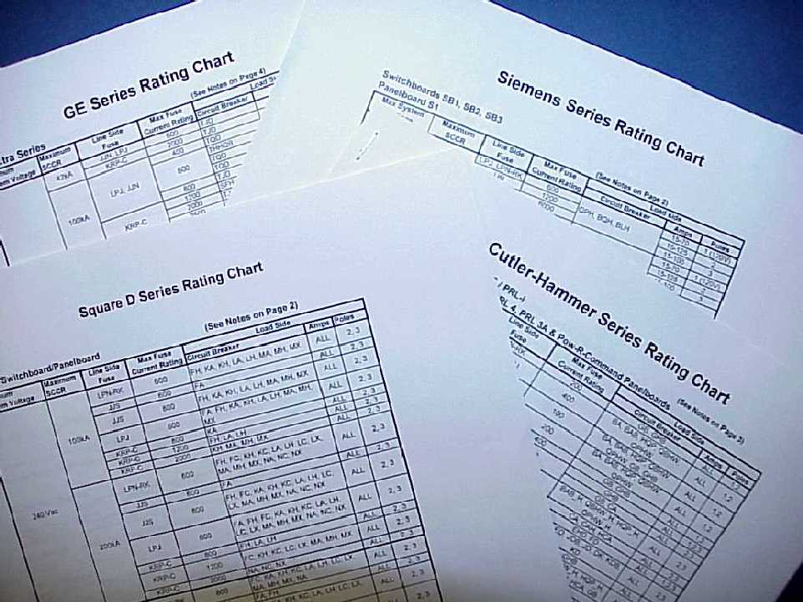
Notes:
These are samples of the tables that are available at www.bussmann.com. First, go to the “Application Info” section, then to “IAEI Information”, then to “Series Rated Combinations” under “Other Related Information”, then to the specific manufacturer’s chart.
Manufacturers’ Series Rating charts are available for free downloading at eaton.com/bussmannseries. First, go to the “Resources” section, then to “Education”, then to “Solution Center Library”, then to “Series Ratings in the first column, then click on “Manufacturer Series
Rating Charts”. These charts provide the many thousands of tested fuse/CB series rated combinations by panelboard type.
This form is available on eaton.com/bussmannseries

Slide 39
Inspecting Systems Using Series Rated Combinations
Notes:
Inspection of series rated systems can be a real challenge.

Slide 40
Inspecting Systems Using Series Rated Combinations
Verify if proper devices are being used by checking Manufacturer’s Label
Verify proper devices are installed by checking Field Installed Label
Verify if series rated combination is allowed due to Motor Contributions
Verify if series rated combination is allowed due to Selective Coordination Requirements
Notes:
First, check to make sure that the manufacturer’s label or bulletin shows the combination to be utilized. Second, check to see if the field installed labels show the series rating, the device part numbers, panel designations, and locations. Third, verify that the motor load, connected between the line side device and load side circuit breakers, does not exceed 1% of the interrupting rating of the load side circuit breakers. And fourth, check to make sure that the lack of selective coordination associated with series rated systems is allowed at the point of application.

Slide 41
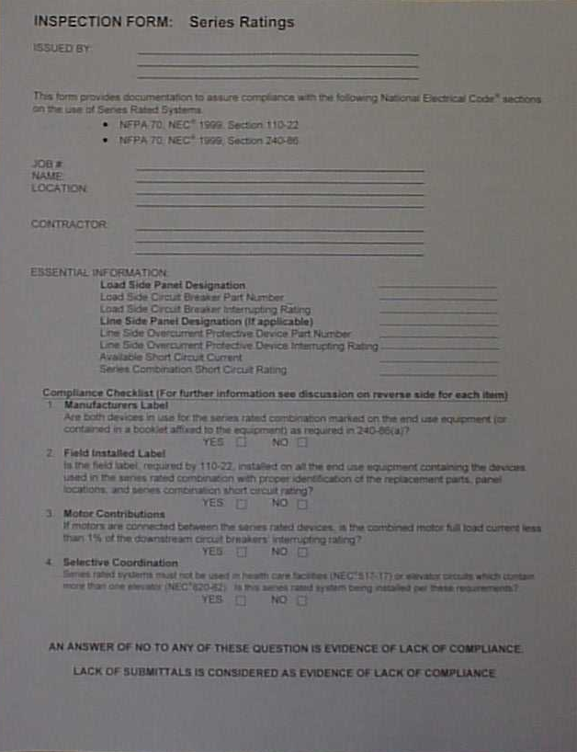
Series Rated Combination
Inspection Form
Notes:
“Series Rating” inspection forms are available for free downloading at eaton.com/bussmannseries. First, go to the “Resources” section, then to “Education”, then to “Solution Center Library”, then to “Series Ratings in the second column, then click on “checklist”. This forms provide a simple checklist of the major requirements associated with series rated systems.
This form is available on eaton.com/bussmannseries

Slide 42


